Slide 1
FLUTTER APP FOR FINANCE TARCKING
BY ANURAG MISHRA

Slide 2
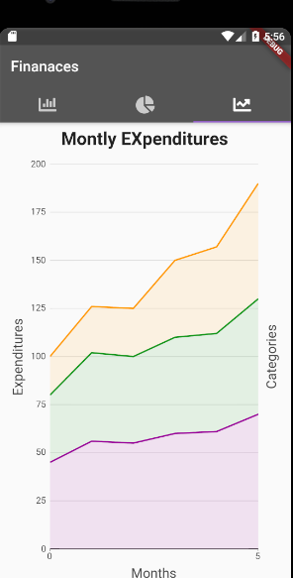
FINANCE APP
DESIGNED TO TACK EXPNSES OF STUDENTS
REDUDUCES OVER EXPENDITURE BY STUDENETS
GIVES A HOLISTIC VIEW OF THE EXPENDITURE

Slide 3
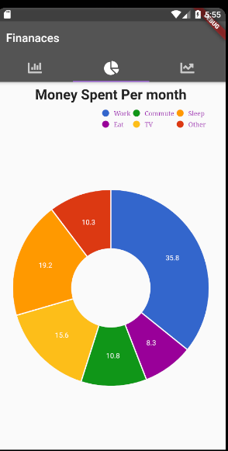
FINANCE APP
FLUTTER IS USED SO THAT IT’S EISIER TO DEPLOY
FOR GREAT REPRESENTATION MATERIAL UI IS USED
USES CHARTS TO GIVE A VIEW OF YOUR EXPENSES

Slide 4
TARGET GROUP
STUDENTS
FACULTY
ANY OTHER PERSON WHO WANTS TO MANAGE HIS OR HER EXPENSES.

Slide 5
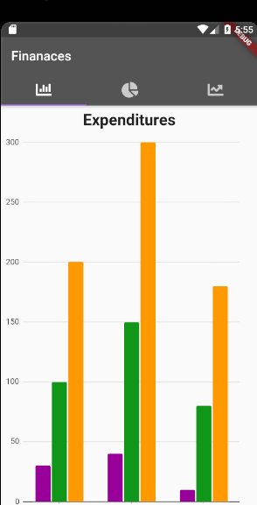
SCREEN SHOTS

Slide 6
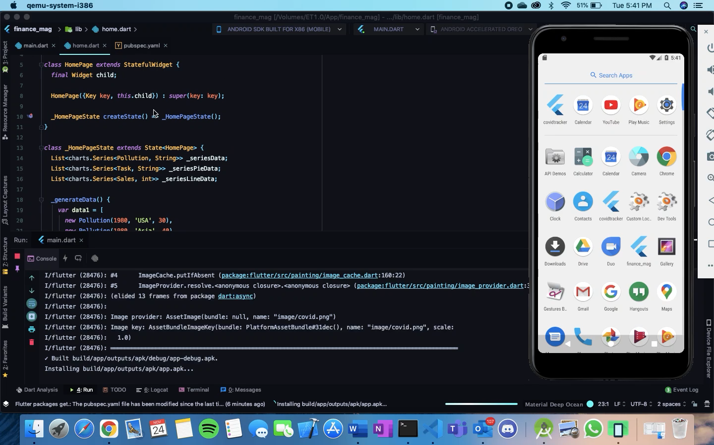
WORK FLOW

Slide 7
THANKS

